Slide 1
Advanced Web Technology

Slide 2
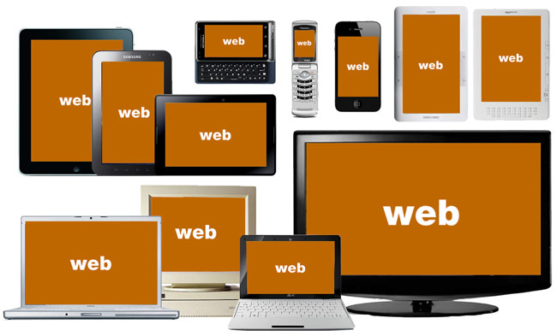
Advance Web Technology
Wikipedia
Facebook
Delicious
Twitter
Blogger
YouTube
MySpace
Flickr

Slide 3
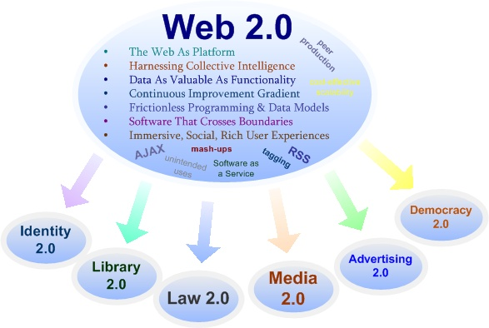
Web 2.0 Introduction and Concepts

Slide 4
What is Web 2.0?
It is Second generation of services available on the Web that lets people collaborate and share information online
O'Reilly Media and MediaLive International popularized the term
Google is now seen as the torch bearer of the term by the media
From a technology perspective Web 2.0 uses AJAX, Mashups and RSS predominantly
Notes:
The second stage of development of the Internet, characterized especially by the change from static web pages to dynamic or user-generated content and the growth of social media.
A Web 2.0 site may allow users to interact and collaborate with each other in a social media dialogue as creators of user-generated content in a virtual community, in contrast to Web sites where people are limited to the passive viewing of content. Examples of Web 2.0 include social networking sites, blogs, wikis, folksonomies, video sharing sites, hosted services, Web applications, and mashups.

Slide 5
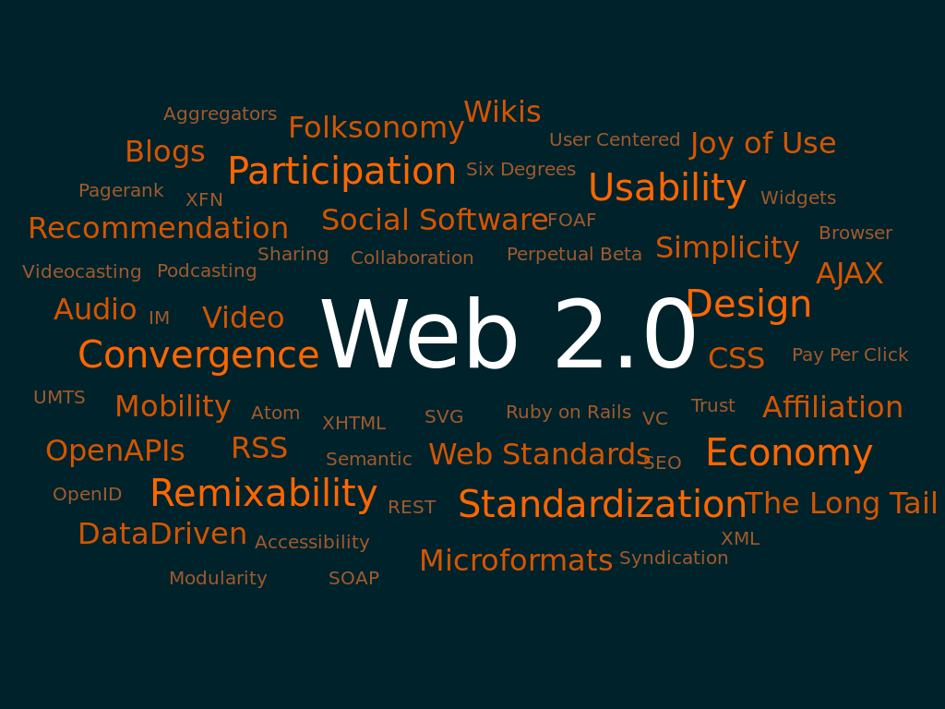

Slide 6
Web 2.0: Evolution Towards a Read/Write Platform:
Web 1.0 (1993-2003) Pretty much HTML pages viewed through a browser |  | Web 2.0 (2003- beyond) Web pages, plus a lot of other “content” shared over the web, with more interactivity; more like an application than a “page”
“Read” | Mode | “Write” & Contribute
“Page” | Primary Unit of content | “Post / record”
“static” | State | “dynamic”
Web browser | Viewed through… | Browsers, RSS Readers, anything
“Client Server” | Architecture | “Web Services”
Web Coders | Content Created by… | Everyone
“geeks” | Domain of… | “mass amatuerization”

Slide 7
Web 1.0 | Web 2.0
DoubleClick | Google AdSense
Ofoto | Flickr
Akamai | BitTorrent
mp3.com | Napster
Britannica Online | Wikipedia
personal websites | blogging
evite | upcoming.org and EVDB
domain name speculation | search engine optimization
page views | cost per click
screen scraping | web services
publishing | participation
content management systems | wikis
directories (taxonomy) | tagging ("folksonomy")
stickiness | syndication

Slide 8
Web 2.0 Concepts
Web 2.0 can be described in three parts:
Rich Internet application (RIA) — defines the experience brought from desktop to browser whether it is from a graphical point of view or usability point of view.
Web-oriented architecture (WOA) — is a key piece in Web 2.0, which defines how Web 2.0 applications expose their functionality so that other applications can leverage and integrate the functionality providing a set of much richer applications. Examples are feeds, RSS, Web Services, mash-ups.
Social Web — defines how Web 2.0 tends to interact much more with the end user and make the end-user an integral part.

Slide 9
Web 3.0 (Not Exists)
Web 3.0 is one of the terms used to describe the evolutionary stage of the Web that follows Web 2.0.
Given that technical and social possibilities identified in this latter term are yet to be fully realized the nature of defining Web 3.0 is highly speculative.
In general it refers to aspects of the Internet which, though potentially possible, are not technically or practically feasible at this time.

Slide 10
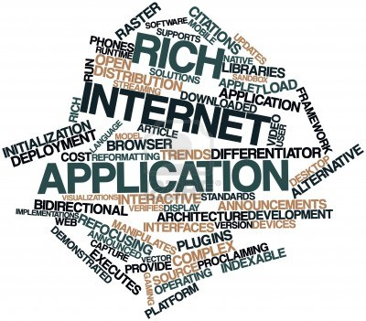
Rich Internet Application Development
A rich Internet application (RIA)
sometimes called an Installable Internet Application,
Is a Web application that has many of the characteristics of desktop application software,
Typically delivered by way of a site-specific browser,
A browser plug-in, an independent sandbox, extensive use of JavaScript, or a virtual machine.
Adobe Flash, JavaFX, and Microsoft Silverlight are currently the three most common platforms
Notes:
JavaFX is a software platform for creating and delivering desktop applications, as well as rich internet applications (RIAs) that can run across a wide variety of devices. JavaFX is intended to replace Swing as the standard GUI library for Java SE, but both will be included for the foreseeable future.

Slide 11
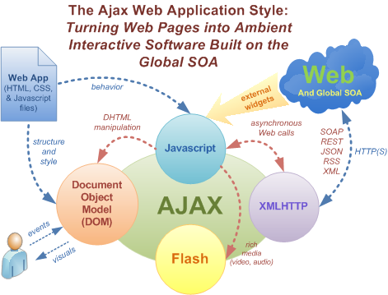
AJAX
Ajax is not a technology in itself
Shorthand for Asynchronous JavaScript and XML
The term was first used by Adaptive Path only in Feb 2005
Removes the need to reload entire web page each time the user makes a change. Increase the web page's interactivity, speed, and usability.
XML is used as the format for transferring data between the server and client. XML files may be created dynamically by some form of server-side scripting
The Ajax technique uses a combination of: XHTML and CSS, JavaScript, XMLHttpRequest /IFrame object

Slide 12
AJAX Frameworks
Prototype Library,
DWR JAVA AJAX Frameworks

Slide 13
List of Ajax frameworks
frameworks | License
JQuery | GPL and MIT
MooTools | MIT
Prototype | MIT
YUI Library | BSD
ASP.NET AJAX | Microsoft Public License
Spry framework (no longer) | MIT
Dojo Toolkit | modified BSD license or the Academic Free License
Ext JS | GPLv3 or proprietary
Backbone.js | MIT
AngularJS | MIT
Notes:
- jQuery, a JavaScript library that provides an Ajax framework and other utilities, and jQuery UI, a plug-in that provides abstractions for low-level interaction and animation, advanced effects and high-level, themeable widgets.
- MooTools, a compact and modular JavaScript framework best known for its visual effects and transitions.
Prototype, a JavaScript framework that provides Ajax and other utilities, and Script.aculo.us, a plug-in for animations and interface development.
YUI Library, a set of utilities and controls, for building richly interactive web applications using techniques such as DOM scripting, DHTML and Ajax.
ASP.NET AJAX, a set of extensions to ASP.NET for implementing Ajax functionality.
Spry framework, an open source Ajax framework developed by Adobe which is used in the construction of Rich Internet applications. It is no longer maintained.
Dojo Toolkit, an Open Source DHTML toolkit written in JavaScript.
Ext JS, a library that extends Prototype, Jquery and YUI until version 1.0. Since version 1.1 a standalone Ajax framework.
Backbone.js, loosely based on the Model-View-Controller application design paradigm

Slide 14
Frameworks in Java for server-side Ajax operations
Apache Wicket: An open-source Java server-centric framework supporting Ajax development AribaWeb: An open-source framework with Reflection and Object-Relational mapping Backbase: Enterprise Ajax for JSF DWR Direct Web Remoting Echo for Ajax servlets FormEngine: A framework for easy creation of dynamic forms Google Web Toolkit: A widget library with a Java to JavaScript compiler ItsNat: A server-side Java framework focused on single-page interface applications JackBe: Enterprise Ajax framework JSF: Java Server Faces | OpenXava: Model-driven framework for creating Ajax business applications RAP: Eclipse Rich Ajax Platform JBoss RichFaces, ICEfaces and PrimeFaces: Open-source Ajax component libraries for JavaServer Faces Tersus: An open-source platform for developing rich web applications by visual programming Vaadin: A server-side Java widget framework utilizing GWT ZK: An open-source Java server + client fusion Ajax framework utilizing jQuery and XUL

Slide 15
Prototype Library
Prototype takes the complexity out of client-side web programming.
Built to solve real-world problems,
It adds useful extensions to the browser scripting environment and provides elegant APIs around the clumsy interfaces of Ajax and the Document Object Model
To learn how to use it just visit
http://prototypejs.org/learn/

Slide 16
DWR JAVA AJAX Framework
The DWR project was started by Joe Walker in 2004,
1.0 released at 29 Aug 2005.
DWR, or Direct Web Remoting, is a Java open source library that helps developers write web sites that include Ajax technology.
It allows code in a web browser to use Java functions running on a web server as if those functions were within the browser.
It consists of two main parts:
Code to allow JavaScript to retrieve data from a servlet-based web server using Ajax principles.
A JavaScript library that makes it easier for the web site developer to dynamically update the web page with the retrieved data.

Slide 17
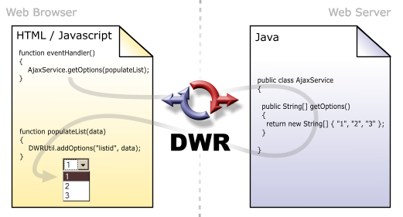
DWR features
DWR has a number of features like
Call batching,
Marshalling of virtually any data-structure between Java and Javascript (including binary file uploading and downloading),
Exception handling,
Advanced CSRF protection and
Deep integration with several Java server-side technologies like Spring and Guice.
Notes:
- In computer science, marshalling or marshaling is the process of transforming the memory representation of an object to a data format suitable for storage or transmission, and it is typically used when data must be moved between different parts of a computer program or from one program to another. Marshalling is similar to serialization and is used to communicate to remote objects with an object, in this case a serialized object. It simplifies complex communication, using custom/complex objects to communicate instead of primitives. The opposite, or reverse, of marshalling is called unmarshalling (or demarshalling, similar to deserialization)
- Guice (pronounced 'juice') is a lightweight dependency injection framework for Java 6 and above

Slide 18
Getting Started with DWR
http://directwebremoting.org/dwr/introduction/getting-started.html

