Slide 1
Enterprise JAVA Bean

Slide 2
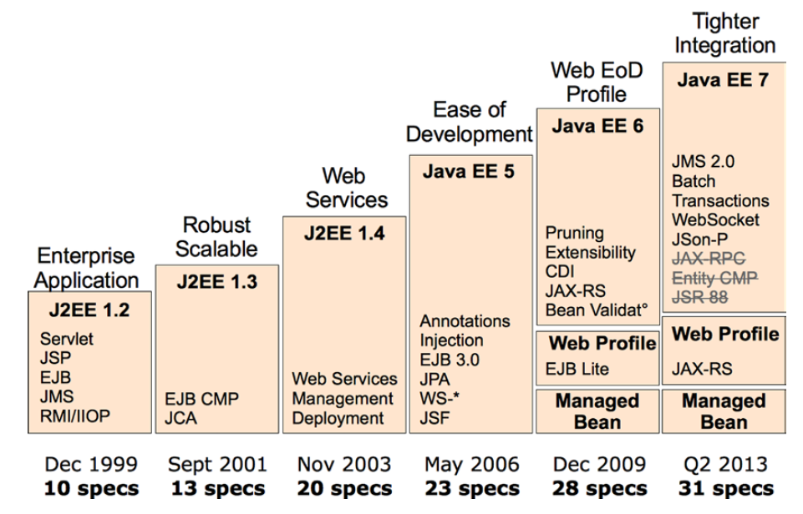

Slide 3
Enterprise JAVA Bean
EJB is a development architecture for
Building highly scalable and
Robust enterprise level applications,
To be deployed on J2EE compliant Application.
EJB 3.0 is being a great shift from EJB 2.0 and makes development of EJB based applications quite easy.
Notes:
J2EE platform have component based architecture to provide multi-tiered, distributed and highly transactional features to enterprise level applications.

Slide 4
What Is an Enterprise Bean?
An enterprise bean is a server-side component that encapsulates the business logic of an application.
The business logic is the code that fulfills the purpose of the application.
In an inventory control application, for example,
the enterprise beans might implement the business logic in methods called checkInventoryLevel and orderProduct.
By invoking these methods, clients can access the inventory services provided by the application.

Slide 5
EJBs act as an entry point for presentation-tier technologies like Java Server Faces (JSF) but also for all external services (JMS or web services).
An EJB container is a runtime environment that provides services, such as transaction management, concurrency control, pooling, and security authorization.
Historically, application servers have added other features such as clustering, load balancing, and failover.
EJB developers can then concentrate on implementing business logic while the container deals with all the technical plumbing.

Slide 6
Benefits
Simplified development of large scale enterprise level application.
Application Server/ EJB container provides most of the system level services like transaction handling, logging, load balancing, persistence mechanism, exception handling and so on. Developer has to focus only on business logic of the application.
EJB container manages life cycle of ejb instances thus developer needs not to worry about when to create/delete ejb objects.

Slide 7
Types
Type | Description
Session Bean | Session bean stores data of a particular user for a single session. It can be stateful or stateless. It is less resource intensive as compared to entity beans. Session bean gets destroyed as soon as user session terminates.
Entity Bean | Entity beans represents persistent data storage. User data can be saved to database via entity beans and later on can be retrieved from the database in the entity bean.
Message Driven Bean | Message driven beans are used in context of JMS (Java Messaging Service). Message Driven Beans can consumes JMS messages from external entities and act accordingly.
Notes:
The entity beans were replaced by a brand-new specification (JPA), and session beans no longer required home or EJB-specific component interfaces. Resource injection, interceptors, and life-cycle callbacks were introduced.
The Java Persistence API (JPA) is a Java specification for accessing, persisting, and managing data between Java objects / classes and a relational database. JPA was defined as part of the EJB 3.0 specification as a replacement for the EJB 2 CMP Entity Beans specification.
EJB 3.0, entity bean used in EJB 2.0 is largely replaced by persistence mechanism. Now entity bean is a simple POJO having mapping with table.
Following are the key actors in persistence API
Entity - A persistent object representing the data-store record. It is good to be serializable.
EntityManager - Persistence interface to do data operations like add/delete/update/find on persistent object(entity). It also helps to execute queries using Query interface.
Persistence unit (persistence.xml) - Persistence unit describes the properties of persistence mechanism.
Data Source (*ds.xml) - Data Source describes the data-store related properties like connection url. user-name,password etc.
In software engineering, a plain old Java object (POJO) is an ordinaryJava object, not bound by any special restriction. The term was coined by Martin Fowler, Rebecca Parsons and Josh MacKenzie in September 2000:

Slide 8
Session Bean
Stateless
The session bean contains no conversational state between methods, and any instance can be used for any client. It is used to handle tasks that can be concluded with a single method call.
Stateful
The session bean contains conversational state, which must be retained across methods for a single user. It is useful for tasks that have to be done in several steps.
Singleton
A single session bean is shared between clients and supports concurrent access. The container will make sure that only one instance exists for the entire application.
Notes:
Session beans are great for implementing business logic, processes, and workflow. And because enterprise applications can be complex, the Java EE platform defines several types of EJBs. A session bean may have the following traits:
The three types of session beans all have their specific features, of course, but they also have a lot in common. First of all, they have the same programming model. Session bean can have a local and/or remote interface, or no interface at all. Session beans are container-managed components, so they need to be packaged in an archive (jar, war, or ear file) and deployed to a container.

Slide 9
Message-driven beans (MDBs)
Is used for integrating with external systems by receiving asynchronous messages using JMS. Even though MDBs are part of the EJB specification.
MDBs usually delegate the business logic to session beans

Slide 10
Services Given by the Container
Remote client communication:
Without writing any complex code, an EJB client (another EJB, a user interface, a batch process, etc.) can invoke methods remotely via standard protocols.
Dependency injection:
The container can inject several resources into an EJB (JMS destinations and factories, datasources, other EJBs, environment variables, etc.) as well as any POJO thanks to CDI.
Notes:
No matter if the container is embedded or runs in a separate process, it provides core services common to many enterprise applications such as the following:

Slide 11
Services Given by the Container
State management:
For stateful session beans, the container manages their state transparently. You can maintain state for a particular client, as if you were developing a desktop application.
Pooling:
For stateless beans and MDBs, the container creates a pool of instances that can be shared by multiple clients. Once invoked, an EJB returns to the pool to be reused instead of being destroyed.
Component life cycle:
The container is responsible for managing the life cycle of each component.

Slide 12
Services Given by the Container
Messaging:
The container allows MDBs to listen to destinations and consume messages without too much JMS plumbing.
Transaction management:
With declarative transaction management, an EJB can use annotations to inform the container about the transaction policy it should use. The container takes care of the commit or the rollback.
Security:
Class or method-level access control can be specified on EJBs to enforce user and role authorization.

Slide 13
Services Given by the Container
Concurrency support:
Except for singletons, where some concurrency declaration is needed, all the other types of EJB are thread-safe by nature. You can develop high-performance applications without worrying about thread issues.
Interceptors:
Cross-cutting concerns can be put into interceptors, which will be invoked automatically by the container.
Asynchronous method invocation:
Since EJB 3.1, it’s now possible to have asynchronous calls without involving messaging.
Notes:
Once the EJB is deployed, the container takes care of these features, leaving the developer to focus on business logic while benefiting from these services without adding any system-level code. EJBs are managed objects. In fact they are considered to be Managed Beans. When a client invokes an EJB, it doesn’t work directly with an instance of that EJB but rather with a proxy on an instance. Each time a client invokes a method on an EJB, the call is actually proxied and intercepted by the container, which provides services on behalf of the bean instance. Of course, this is completely transparent to the client; from its creation to its destruction, an enterprise bean lives in a container.
In a Java EE application, the EJB container will usually interact with other containers: the Servlet container (responsible for managing the execution of Servlets and JSF pages), the application client container (ACC) (for managing stand-alone applications), the message broker (for sending, queuing, and receiving messages), the persistence provider, and so on.

Slide 14
EJBs a set of service cannot create or manage
threads,
access files using java.io,
create a ServerSocket,
load a native library, or
use the AWT (Abstract Window Toolkit)or
Swing APIs to interact with the user.

Slide 15
EJB Lite
The specification defines a minimal subset of the full EJB API known as EJB Lite.
It includes a small, powerful selection of EJB features suitable for writing portable transactional and secure business logic.
Any EJB Lite application can be deployed on any Java EE product that implementsEJB 3.2.

Slide 16
Comparison Between EJB Lite and Full EJB
Feature | EJB Lite | Full EJB 3.2
Session beans (stateless, stateful, singleton) | Yes | Yes
No-interface view | Yes | Yes
Local interface | Yes | Yes
Interceptors | Yes | Yes
Transaction support | Yes | Yes
Security | Yes | Yes
Embeddable API | Yes | Yes
Asynchronous calls | No | Yes
MDBs | No | Yes
Remote interface | No | Yes
JAX-WS web services | No | Yes
JAX-RS web services | No | Yes
Timer service | No | Yes
RMI/IIOP interoperability | No | Yes
Notes:
Note:- Since the beginning the EJB specifications required the capability of using RMI/IIOP to export EJB components and to access EJB components over a network. This requirement allowed interoperability between Java EE products. This requirement has been pruned in EJB 3.2 and might become optional in future releases, because RMI/IIOP has been largely superseded by modern web technologies that provide interoperability support, such as SOAP and REST.

Slide 17
EJB Specification Overview
Notes:
EJB 1.0 was created back in 1998, and EJB 3.2 was released in 2013 with Java EE 7. During these 15 years, the EJB specification went through many changes, but it still retains its mature foundations. From heavyweight components to annotated POJOs, from Entity Bean CMP to JPA, EJBs have reinvented themselves to meet the needs of developers and modern architectures. More than ever, the EJB 3.2 specification helps to avoid vendor lock-in by providing features that were previously nonstandard (such as nonstandard JNDI names or embedded containers). Today, EJB 3.2 is much more portable than in the past.

Slide 18
Writing Enterprise Java Beans
@Stateless
public class BookEJB {
@PersistenceContext(unitName = “YourName")
private EntityManager em;
public Book findBookById(Long id) {
return em.find(Book.class, id);
}
public Book createBook(Book book) {
em.persist(book);
return book;
}
}
Notes:
Session beans encapsulate business logic, are transactional, and rely on a container that does pooling, multithreading, security, and so on.

Slide 19
Anatomy of an EJB
A bean class:
The bean class contains the business method implementation and can implement zero or several business interfaces. The session bean must be annotated with @Stateless, @Stateful, or @Singleton depending on its type.
Business interfaces:
These interfaces contain the declaration of business methods that are visible to the client and implemented by the bean class. A session bean can have local interfaces, remote interfaces, or no interface at all (a no-interface view with local access only).

Slide 20
Bean class has several types of business interfaces

Slide 21
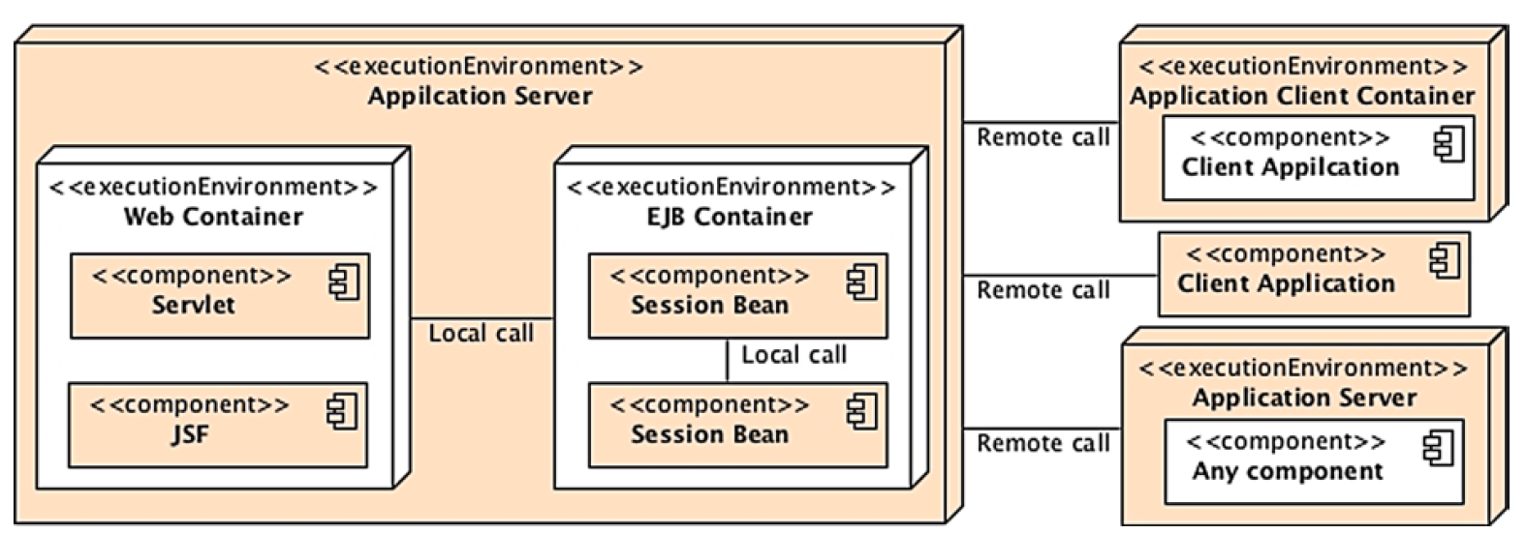
Remote, Local, and No-Interface Views
Notes:
Depending from where a client invokes a session bean, the bean class will have to implement remote or local interfaces, or no interface at all. If your architecture has clients residing outside the EJB container’s JVM instance, they must use a remote interface. As shown in Figure, this applies for clients running in a separate JVM (e.g., a rich client), in an application client container (ACC), or in an external web or EJB container. In this case, clients will have to invoke session bean methods through Remote Method Invocation (RMI). You can use local invocation when the bean and the client are running in the same JVM. That can be an EJB invoking another EJB or a web component (Servlet, JSF) running in a web container in the same JVM. It is also possible for your application to use both remote and local calls on the same session bean.

Slide 22
EJB - Environment Setup
EJB is a framework for Java, so the very first requirement is to have JDK installed in your machine.

Slide 23
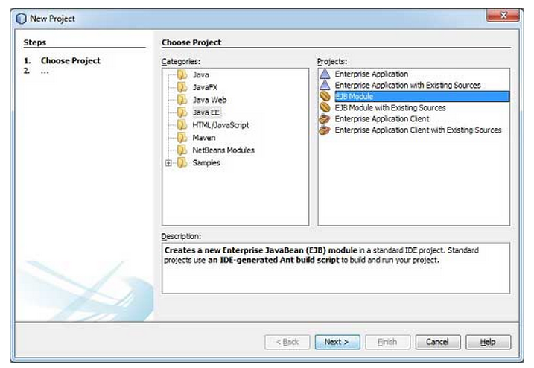
Create Project

Slide 24
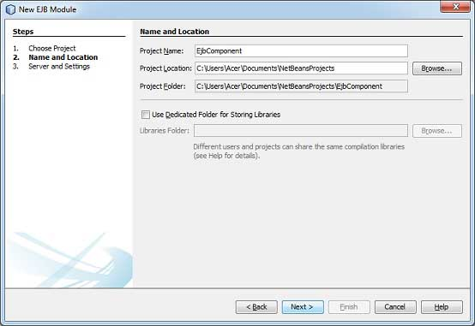

Slide 25
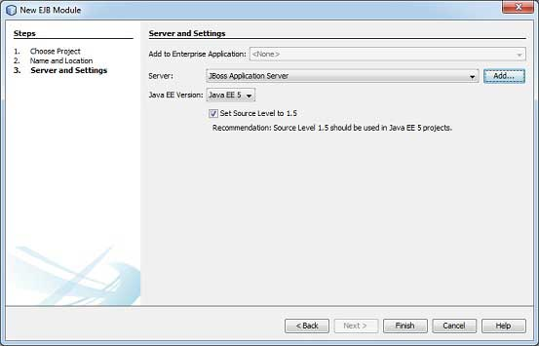

Slide 26
EJB - Stateless Bean
A stateless session bean is a type of enterprise bean which is normally used to do independent operations.
A stateless session bean as per its name does not have any associated client state, but it may preserve its instance state.
EJB Container normally creates a pool of few stateless bean's objects and use these objects to process client's request. Because of pool, instance variable values are not guaranteed to be same across lookups/method calls.

Slide 27
Steps required to create a stateless EJB
Create a remote/local interface exposing the business methods.
This interface will be used by the EJB client application.
Use @Local annotation if EJB client is in same environment where EJB session bean is to be deployed.
Use @Remote annotation if EJB client is in different environment where EJB session bean is to be deployed.
Create a stateless session bean implementing the above interface.
Use @Stateless annotation to signify it a stateless bean. EJB Container automatically creates the relevant configurations or interfaces required by reading this annotation during deployment.

Slide 28
Remote Interface
import javax.ejb.Remote;
@Remote
public interface LibrarySessionBeanRemote {
//add business method declarations
}

Slide 29
Stateless EJB
@Stateless
public class LibrarySessionBean implements LibrarySessionBeanRemote {
//implement business method
}

Slide 30
Enterprise JavaBean Architecture
The Enterprise JavaBeans architecture defines a standard model for Java application servers to support “Write Once, Run Anywhere” (WORA) portability
EJB technology takes the WORA concept to a new level.
EJB completely portable across any vendor’s EJB compliant application server. The EJB environment automatically maps the component to the underlying vendor-specific infrastructure services.
Notes:
What is WORA?

Slide 31
Enterprise JavaBeans
The EJB architecture specifies the responsibilities and interactions among EJB entities
EJB Servers
EJB Containers
Enterprise Beans
EJB Clients
Enterprise
Bean
Enterprise
Bean
EJB Container
Clients
Clients
EJB Server

Slide 32
EJB Server
Provides a Runtime Environment
The EJB Server provides system services and manages resources
Process and thread management
System resources management
Database connection pooling and caching
Management API

Slide 33
EJB Container
Provides a Run-time Environment for an Enterprise Bean
Hosts the Enterprise JavaBeans
Provides services to Enterprise JavaBeans
Naming
Life cycle management
Persistence (state management)
Transaction Management
Security
Likely provided by server vendor

Slide 34
Enterprise JavaBeans
A specialized Java class where the real business logic lives
May be developer-written or tool-generated
Distributed over a network
Transactional
Secure
Server vendors provide tools that automatically generate distribution, transaction and security behaviour
Enterprise
Bean
Enterprise
Bean
EJB Container
EJB Server

Slide 35
EJB Clients
Client access is controlled by the container in which the enterprise Bean is deployed
Clients locates an Enterprise JavaBean through Java Naming and Directory Interface (JNDI)
RMI is the standard method for accessing a bean over a network

Slide 36
What’s Unique About EJB
Declarative Programming Model
Mandates a container model where common services are declared, not programmed
At development and/or deployment time, attributes defining the bean’s transaction and security characteristics are specified
At deployment time, the container introspects the Enterprise JavaBean attributes for the runtime services it requires and wraps the bean with the required functionality
At runtime, the container intercepts all calls to the object
Provides transactional, threading and security behavior required before the method invocation
Invokes the method on the object
Cleans up after the call

Slide 37
Entity Bean
Represents Data
Implements javax.ejb.EntityBean interface
Maps a data source to a Java class
table, view, join or stored procedure in a relational database
a set of related records in a database
legacy data
Each instance of an entity bean is one row of data
Each instance of an entity bean is uniquely identified by a primary key
An Entity Bean can also have additional methods for business logic, etc.

Slide 38
Comparing Session and Entity Beans
Session Beans | Entity Beans
Mandatory for EJB 1.0 Represents a specific client (1 instance per client) Short-lived Transient Can be any Java class May be transactional Business Logic Beans | Optional for EJB 1.0 Represents underlying data object or context (clients share instance) Long-lived Persistent Can be a class that maps to persistent data (e.g., database) Always transactional Beans which represent data

Slide 39
EJB Persistence
Provides Entity Beans the ability to store and retrieve their state
Can be implemented by a bean
Bean Managed Persistence
Can be implemented by a container
Container Managed Persistence

Slide 40
Bean Managed Persistence
The entity bean is responsible for its persistent behavior
EJB developer must implement database access
ejbCreate(…), ejbLoad(), ejbStore(), ejbRemove()
Not automated, developer manually creates mapping through JDBC calls
Not as reusable
Hard-code database access within class
Advanced features like connection pooling and caching are difficult to support because of reliance on hand written code

Slide 41
Container Managed Persistence
The EJB container is responsible for persistence
The container provides tools that generate code in the EJB class that maps methods in the bean to a result set
Can map to a table, view, join or stored procedure in a database
Server provides automated mapping to convert relational data to bean instances
Advanced features like connection pooling and caching are easily supported
High reuse

