Slide 1
Service Oriented Architecture

Slide 2
Service Oriented Architecture
SOA is an architectural pattern in software design.
SOA application components provide services to other components via a communications protocol, typically over a network.
The principles of service-orientation are independent of any vendor, product or technology.

Slide 3
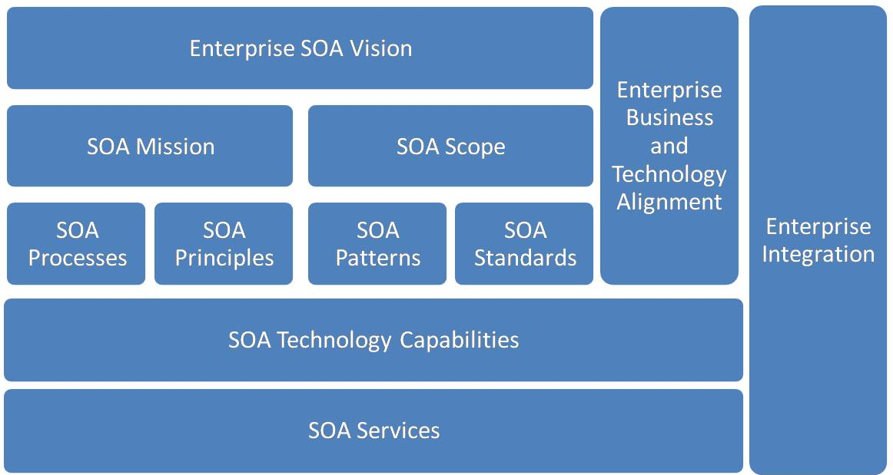

Slide 4
SOA Concepts and Principles
Design Concept
  SOA is based on the concept of a service.
  Depending on the service design approach taken,
  Each SOA service is designed to perform one or more activities by implementing one or more service operations.
  SOA defines how to integrate widely disparate applications for a Web-based environment and uses multiple implementation platforms. Rather than defining an API, SOA defines the interface in terms of protocols and functionality. An endpoint is the entry point for such a SOA implementation.

Slide 5
Types of SOA services
There are several types of services used in SOA systems.
• Business services
• Entity services
• Functional services
• Utility services

Slide 6
SOA benefits
Ability to build business applications faster and more easily
Easier maintenance / update
Business agility and extensibility
Lower total cost of ownership

Slide 7
XML
The eXtensible Markup Language (XML),
Derived from the Standard Generalized Markup Language (SGML),
Was originally envisioned as a language for defining new document formats for the World Wide Web

Slide 8
XML Document
<?xml version="1.0" encoding="UTF-8" ?>
<order id="1234" date="05/06/2013">
<customer first_name="James" last_name="Rorrison">
<email>j.rorri@me.com</email>
<phoneNumber>+44 1234 1234</phoneNumber>
</customer>
<content>
<order_line item="H2G2" quantity="1">
<unit_price>23.5</unit_price>
</order_line>
<order_line item="Harry Potter" quantity="2">
<unit_price>34.99</unit_price>
</order_line>
</content>
<credit_card number="1357" expiry_date="10/13" control_number="234" type="Visa"/>
</order>
Notes:
An XML Document Representing a Purchase Order

Slide 9
XML Terminology
Terminology | Definition
Unicode character | An XML document is a string of characters represented by almost every legal Unicode character
Markup and content | The Unicode characters are divided into markup and content. Markups begin with the character < and end with a > (<email>) and what is not markup is considered to be content (such as j.rorri@me.com)
Tag | Tags come in three flavors of markups: start-tags (<email>), end-tags (</email>) and empty-element tags (<email/>)
Element | An element begins with a start-tag and ends with a matching end-tag (or consists only of an empty-element tag). It can also include other elements, which are called child elements. An example of an element is <email>j.rorri@me.com</email>
Attribute | An attribute consists of a name/value pair that exists within a start-tag or empty-element tag. In the following example item is the attribute of the order_line tag: <order_line item="H2G2">
XML Declaration | XML documents may begin by declaring some information about themselves, as in the following example: <?xml version="1.0" encoding="UTF-8" ?>

Slide 10
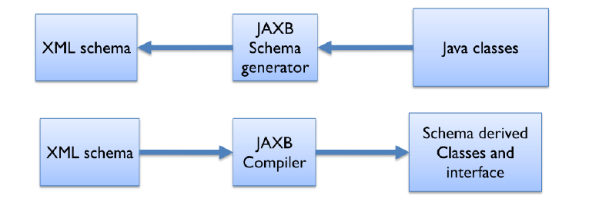
XML Binding in Java
JAXB: Java Architecture for XML Binding
Notes:
Java Architecture for XML Processing (JAXP) is an API that provides a common, implementation-independent interface for creating and using the SAX, DOM, and XSLT APIs in Java.
Prior to JAXP, there were different incompatible versions of XML parsers and transformers from different vendors. JAXP has provided an abstraction layer on top of these vendor-specific XML API implementations to parse
and transform XML resources.
Note that JAXP doesn’t use a different mechanism to parse and transform XML documents. Instead, applications can use it to access the underlying XML APIs indirectly in a common manner. Applications can then replace a
vendor’s implementation with another. Using JAXP, you can parse XML documents with SAX or DOM as the underlying strategy, or transform them to a new format using XSLT.

Slide 11
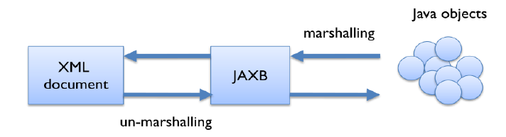
Marshalling and un-marshalling
Notes:
Java Architecture for XML Processing (JAXP) is an API that provides a common, implementation-independent interface for creating and using the SAX, DOM, and XSLT APIs in Java.
Prior to JAXP, there were different incompatible versions of XML parsers and transformers from different vendors. JAXP has provided an abstraction layer on top of these vendor-specific XML API implementations to parse
and transform XML resources.
Note that JAXP doesn’t use a different mechanism to parse and transform XML documents. Instead, applications can use it to access the underlying XML APIs indirectly in a common manner. Applications can then replace a
vendor’s implementation with another. Using JAXP, you can parse XML documents with SAX or DOM as the underlying strategy, or transform them to a new format using XSLT.

Slide 12
SOAP (Simple Object Access protocol)
It is a protocol specification for exchanging structured information in the implementation of web services in computer networks.
It uses XML Information Set for its message format, and relies on other application layer protocols, most notably Hypertext Transfer Protocol (HTTP),
or Simple Mail Transfer Protocol (SMTP), for message negotiation and transmission.

Slide 13
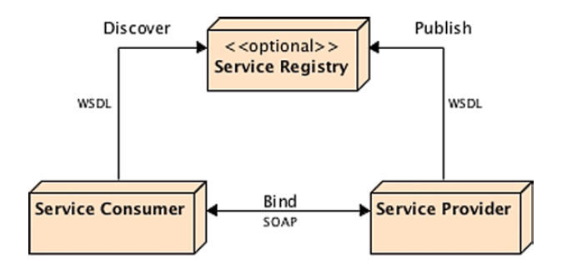
Notes:
SOAP web services depend on several technologies and protocols to transport and to transform data from a consumer to a service provider in a standard way. The ones that you will come across more often are the following:
Extensible Markup Language (XML) is the basic foundation on which SOAP web services are built and defined (SOAP, WSDL, and UDDI).
• Web Services Description Language (WSDL) defines the protocol, interface, message types, and interactions between the consumer and the provider.
• Simple Object Access Protocol (SOAP) is a message-encoding protocol based on XML technologies, defining an envelope for web services communication.
• Messages are exchanged using a transport protocol. Although Hypertext Transfer Protocol (HTTP) is the most widely adopted transport protocol, others such as SMTP or JMS can also be used.
• Universal Description Discovery, and Integration (UDDI) is an optional service registry and discovery mechanism, similar to the Yellow Pages; it can be used for storing and categorizing SOAP web services interfaces (WSDL).
With these standard technologies, SOAP web services provide almost unlimited potential. Clients can call a service, which can be mapped to any program and accommodate any data type and structure to exchange messages through XML.

Slide 14
SOAP Elements and Attributes
Element | Description
Envelope | Defines the message and the namespace used in the document. This is a required root element
Header | Contains any optional attributes of the message or application-specific infrastructure such as security information or network routing
Body | Contains the message being exchanged between applications
Fault | Provides information about errors that occur while the message is processed. This element is optional

Slide 15
SOAP Request
POST /InStock HTTP/1.1
Host: www.bookshop.org
Content-Type: application/soap+xml; charset=utf-8
Content-Length: nnn
<?xml version="1.0"?>
<soap:Envelope xmlns:soap="http://www.w3.org/2001/12/soap-envelope"
soap:encodingStyle="http://www.w3.org/2001/12/soap-encoding">
<soap:Body xmlns:m="http://www.bookshop.org/prices">
<m:GetBookPrice>
<m:BookName>The Fleamarket</m:BookName>
</m:GetBookPrice>
</soap:Body>
</soap:Envelope>

Slide 16
SOAP Response
POST /InStock HTTP/1.1
Host: www.bookshop.org
Content-Type: application/soap+xml; charset=utf-8
Content-Length: nnn
<?xml version="1.0"?>
<soap:Envelope xmlns:soap="http://www.w3.org/2001/12/soap-envelope" soap:encodingStyle="http://www.w3.org/2001/12/soap-encoding">
<soap:Body xmlns:m="http://www.bookshop.org/prices">
<m:GetBookPriceResponse>
<m: Price>10.95</m: Price>
</m:GetBookPriceResponse>
</soap:Body>
</soap:Envelope>

Slide 17
Web Services
Web service is a realization of SOA.
It is important to note that the SOA is an architectural model that is independent of any technology platform and Web Services the most popular SOA implementation.
As the name implies, web services offers services over the web. This is not surprising as the choice of the Internet it already connects many different systems from all over the world.

Slide 18
Web Services Terminologies
Hypertext transfer protocol [HTTP]
Extensible Markup Language [XML]
Web Services Description Language [WSDL]
SOAP

Slide 19
How Do Web Services Work?
A Web service enables this communication by using a combination of open protocols and standards, chiefly XML, SOAP and WSDL.
A Web service uses XML to tag data, SOAP to transfer a message and finally WSDL to describe the availability of services.

