Slide 1
EADD – Introduction
Chapter -1

Slide 2
Challenges in EA Development
Programming Productivity
  Maintain pace of time
  The ability to develop and deploy applications is key to success in the information economy.
  Applications need to go quickly from prototype to production, and to continue evolving even after they are deployed.
  Support a variety of clients, can contribute to both responsiveness and flexibility, or to support several types of clients simultaneously.

Slide 3
Challenges in EA Development
2. Response to Demand
  The ability for applications to scale easily and automatically to accommodate anticipated or unexpected growth is key to achieving the goals.
  Systems need to be designed to handle multiple client interactions with ease.
  They need mechanisms for efficient management of system resources and services such as database connections and transactions.
  Automatic load balancing
  Run on any server appropriate to anticipated client volumes.
  Easily switch server configurations when the need arises.

Slide 4
Challenges in EA Development
3. Integration with Existing Systems
  Challenge for developers of enterprise applications is how to reuse and commoditize informations.
  Developers need standard ways to access middle-tier and backend services such as database management systems.
  Need systems that provide these services consistently, so that new programming models or styles aren’t required as integration expands to encompass various systems within an enterprise.

Slide 5
Challenges in EA Development
4. Freedom to Choose
  Freedom of choice in enterprise application development should extend from servers to tools to components.
  Choices among server products provides the ability to move quickly and easily from one configuration to another as internal and external demand requires.
  Access to the appropriate tools
  Access to tools most appropriate to their skill set and contribution.
  Take advantage of external expertise and to enhance development productivity.

Slide 6
Challenges in EA Development
5. Maintaining Security
  Traditionally, IT departments have been able to maintain a relatively high level of control over the environment of both servers and clients.
  One of the difficulties in integrating disparate systems is providing a unified security model.
  Single signon across internal application and asset boundaries is important to creating a positive user experience with the applications.

Slide 7
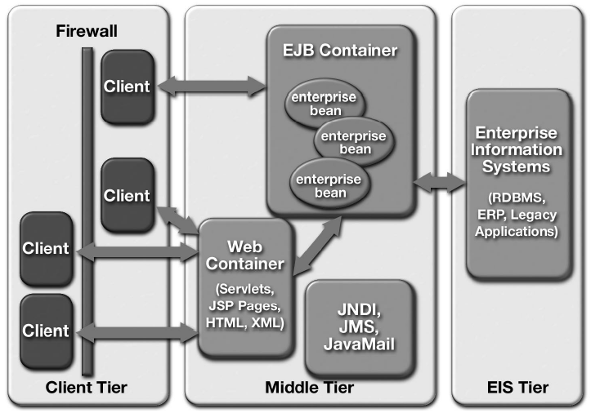
J2EE Platform Overview

Slide 8
J2EE Platform Overview
All J2EE Web containers provide runtime support for responding to client requests, performing request time processing (such as invoking JSP or servlet behavior), and returning results to the client.
All EJB containers provide automated support for transaction and life cycle management of EJB components, as well as bean lookup and other services.
Containers also provide standardized access to enterprise information systems; for example, providing RDBMS access through the JDBC API.
Container provides application behaviors at assembly or deployment time through the use of deployment descriptors

